Slide 1
CROSS EXAMINATION HINTS AND TIPS Frances Heaton QC
NOVEMBER 2015

Slide 2
DEFINITION
Question (a witness called by the other party) in a court of law to challenge or extend testimony already given
Question (someone) aggressively or in great detail
I was cross-examined over the breakfast table

Slide 3
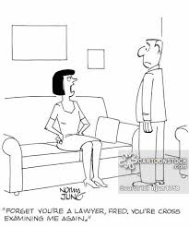
FORGET YOU’RE A LAWYER, FRAN.
YOU’RE CROSS EXAMINING ME AGAIN!

Slide 4
INQUISITORIAL
Not criminal proceedings
Your evidence is one part of the information
The proceedings are in the form of an inquiry
The judge will make the final decision

Slide 5
SOCIAL WORKERS ARE EXPERTS
“Social workers are experts. In just the same way, CAFCASS officers are experts. What has gone wrong with the system is that we have at least two experts in every care case – a social worker and a guardian – and yet we have grown up with the culture of believing that they are not really experts and we therefore need experts with a capital E. Much of the time we do not.” Sir James Munby P 2013

Slide 6
WHY?
Decisions have serious implications
Fair hearing Article 6
Test your opinions
Expose weaknesses in your evidence
Challenge facts
Challenge conclusions
Explore alternatives
It’s part of the job

Slide 7
PREPARATION
Read all the papers
What are the issues?
Record keeping
Decision making
Risk assessment
Significant harm – linkage…..
Realistic options
Plans – placement, contact, order
Statements

Slide 8
TACTICS
Familiarise yourself with the court room
Take the oath or affirm
Glass of water
Listen
Pause
Think
Answer

Slide 9
BEFORE
Meet your advocate [conference]
Discuss the issues
Disclose new information
What are the weaknesses in my evidence
What are the strengths
What topics / issues am I going to asked about
Do you agree with the plan?
READ

Slide 10
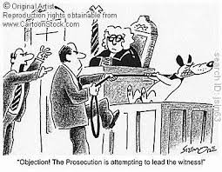
OBJECTION THE APPLICANT IS ATTEMPTING TO LEAD THE WITNESS

Slide 11
DURING
Tell the judge the story
If you didn’t hear the question or don’t understand it – say so
Remember you are not on trial
If you don’t know the answer – say so
Give the positives as well as the negatives
Not finished your answer - say so
If you want to look something up in the bundle – ask for a minute to do so, or a reference

Slide 12
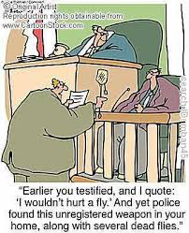

Slide 13
…..and there’s more
Don’t second guess
Don’t forget you can go back to a previous point
Don’t be pressurised answer ‘yes’ or ‘no’ UNLESS that is the answer
Don’t ignore the judge – watch and listen
Don’t forget YOU are giving evidence

Slide 14
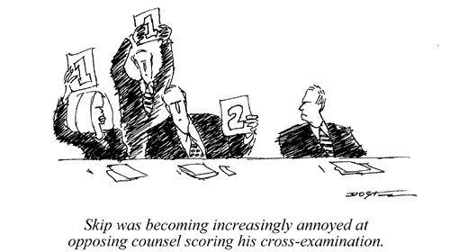

Slide 15
KEEP CALM WE NEED YOU!

Slide 16
AFTER
Ask for feedback
Give feedback
Listen to the judgment
Share your experience – good and bad
Learn

